Slide 1

Narrify: Knowledge-to-Podcast Platform
Transforming organisational knowledge into interactive audio experiences

Slide 2




The Knowledge Gap Challenge
Trapped Information
Manual Curation Burden
Engagement Crisis
Critical knowledge buried in static documents, inaccessible when needed most
Hours wasted converting content, slowing down knowledge distribution
Employees struggle with dense written resources, limiting learning outcomes

Slide 3




Introducing Narrify
AI-powered transformation: documents become dynamic podcast conversations
Upload
Segment
Experience
Any document format
Intelligent AI parsing
Listen & interact

Slide 4





Strategic Business Objectives
Automated Transformation
Engagement Amplification
Zero manual effort in content conversion and curation
Transform passive reading into active listening experiences
Interactive Learning
Real-time interaction with AI personas drives deeper understanding
Voice Innovation
Next-gen learning through conversational AI voices
Effortless Scalability
Handle unlimited documents across global organisations

Slide 5
Seamless User Journey
Upload Content
1
Drag & drop documents instantly
2
AI Processing
Intelligent parsing & analysis
Episode Creation
3
Automatic segmentation into digestible chapters
4
Agent Discussion
Multi-agent conversation simulation
Podcast Ready
5
High-quality audio generation complete
6
Interactive Listen
Engage with AI personas in real-time

Slide 6
Intelligent System Architecture
Frontend Layer
Intuitive web app • Upload interface • Rich playback controls
AI Engine Core
Advanced processing • Document parsing • Episode segmentation • Multi-agent orchestration
Data & Infrastructure
Scalable cloud storage • Secure database • Text-to-speech engine • Authentication & compliance

Slide 7
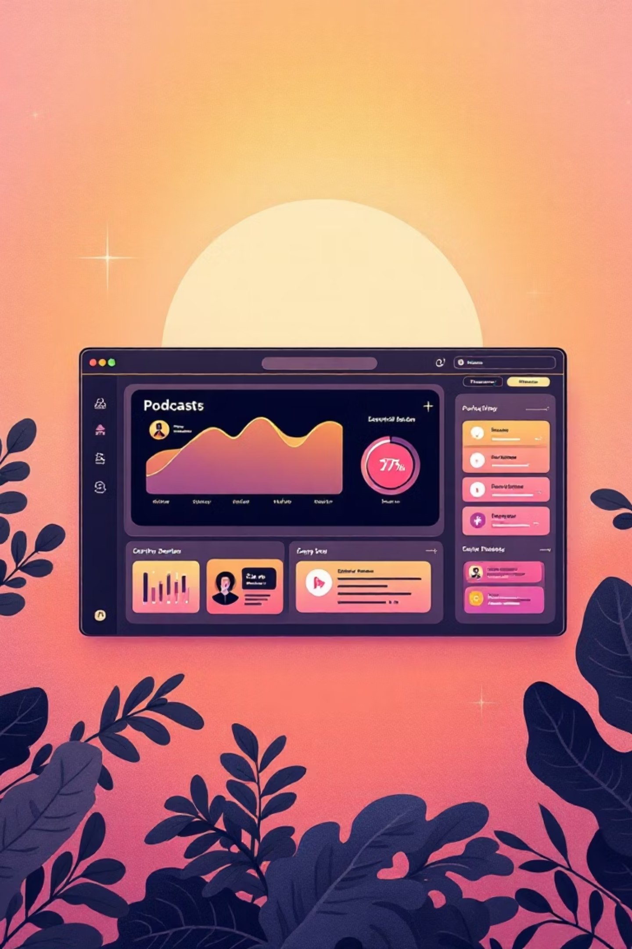

Powerful Feature Modules
1
1
Content Ingestion
Podcast Generation
Multi-format document processing with intelligent extraction
Studio-quality audio with realistic AI voices
2
2
Episode Segmentation
Live Interactive
AI-driven chapter creation for optimal learning flow
Real-time persona engagement during playback
3
3
Conversation Engine
Security & Compliance
Multi-agent dialogue simulation with natural interactions
Enterprise-grade protection for sensitive content

Slide 8

Experience the Interface
🎯 One-Click Upload
⚡ Real-Time Progress
💬 Live AI interaction
Instant document processing
Watch AI transform content
Interact anytime

Slide 9
The Future of Narrify
YouTube Integration
Multilingual Reach
Mobile Experience
Team Collaboration
Direct video-to-podcast conversion for multimedia learning
Podcasts in 50+ languages for worldwide audiences
Native iOS & Android apps for on-the-go learning
Shared workspaces, playlists, and analytics dashboards

Slide 10



Reimagine Learning.Reinvent Knowledge Sharing.
Let's Transform Together
Experience the future of organisational knowledge

Slide 11
Meet the Team Behind Narrify
Our diverse team of experts is dedicated to revolutionizing knowledge sharing.
Core Team
Coaches
Priya Pathak
Parag Lnu
Team Lead
Product Coach
Lavi Kumar
Sagar Shrivastava
Member 1
Tech Coach
Shyam Shukla
Dikshant Verma
Member 2
Devops Coach
Paripakwa Kakaria
Member 3

